Slide 1

Data Strategy

Slide 2
What is Data strategy?
We live in the age of exponential data growth.
Data assets can generate value by improving decision-making and operations including production, distribution, sales and marketing. An effective data strategy can also put data to work for the business on fraud detection and automatic content generation with AI, for example. Specific needs should be derived from the business strategy.

Slide 3
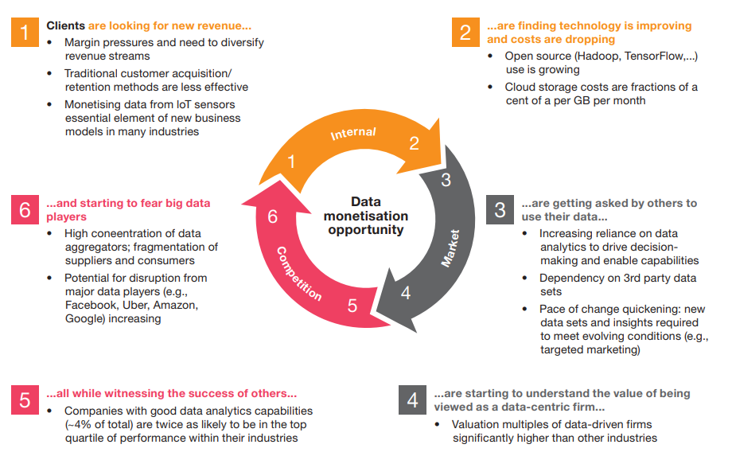

Slide 4
SUMMARY
It is tempting for organisations in to jump on the data investment bandwagon for fear of being left behind. Those that adopt a strategic, systematic and diligent approach to appraising data investments will make the right investments and reap the rewards.

Slide 5
THANK YOU

